Slide 1
GrowMate Your agricultural partner
TSP - PROJECT DEMONSTRATION
Presented By:
Sankit Binkar
Harshal Borkar
Nayana Pardhekar
Harsh Ghatode
Aditya Mate
Guided By:
Mr. Akshay Chaskar

Slide 2
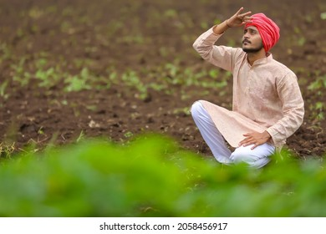
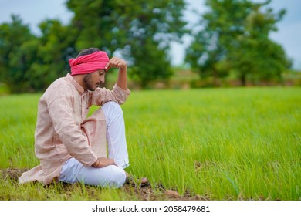
Problem Statement
Farmers face challenges in optimizing crop selection to maximize yield while efficiently utilizing resources. Existing methods often lack precision and fail to account for various environmental factors. This project addresses the gap by proposing a machine learning-based crop and fertilizer recommendation system. It is also difficult to identify Disease and it's cure.

Slide 3



Proposed Solution
We introduce you to GrowMate, an advanced system for crop recommendation, intelligent disease detection, and technological updates, which provides farmers with tailored guidance for crop management. Additionally, a centralized repository of government schemes and focus on sustainable practices that aims to empower farmers for efficient and informed decision-making in agriculture.

Slide 4
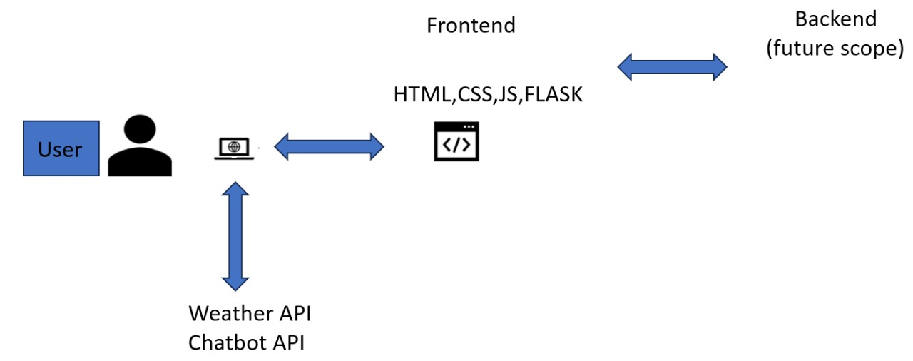
Algorithm & Deployment
Services and Tools used:
RandomForestClassifier Algorithm for crop recommendation
MobileNetV2 Algorithm for disease identification
Openweather API
Chatbot API

Slide 5

Conclusion & Future Scope
GrowMate: Machine Learning based system provides a robust and data-driven approach for farmers to make informed decisions, fostering sustainable agriculture practices and optimizing crop yield in varying environmental conditions. This tool contributes to the modernization of farming strategies.
Future scope:
Focusing more on organic farming methods with new cultivation techniques.
Access to Government schemes and subsidies using API
Database integration

Slide 6
THANK YOU

